Slide 1
Final Engagement
Attack, Defense & Analysis of a Vulnerable Network

Slide 2
Table of Contents
This document contains the following resources:
Network Topology & Critical Vulnerabilities
Exploits Used
Methods Used to Avoiding Detect

Slide 3

Network Topology
& Critical Vulnerabilities
‹#›

Slide 4
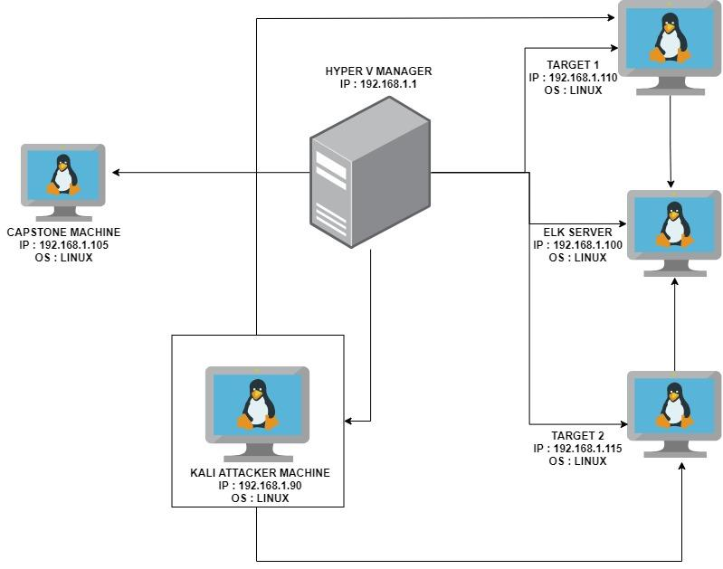
Network Topology
Network
Address Range: 192.168.1.0/24
Netmask: 255.255.255.255
Gateway: 10.0.0.1
Machines
IPv4: 192.168.1.90
OS: LINUX
Hostname: KALI
IPv4: 192.168.1.100
OS: LINUX
Hostname: ELK
IPv4: 192.168.1.110
OS: LINUX
Hostname: TARGET 1
IPv4: 192.168.1.115
OS: LINUX
Hostname: TARGET 2

Slide 5
Critical Vulnerabilities: Target 1
Our assessment uncovered the following critical vulnerabilities in Target 1.
Vulnerability | Description | Impact
WEAK PASSWORD | A USER ON THE SYSTEM HAS A WEAK PASSWORD WHICH WAS EASILY GUESSED. THE PASSWORD WAS THE SAME AS THE USERNAME. | AN ATTACKER CAN GUESS THE PASSWORD OR USE A DICTIONARY ATTACK TO GAIN ACCESS VERY EASILY TO THE SYSTEM.
WORDPRESS USER ENUMERATION | A simple wpscan enumeration scan for vulnerabilities on the wordpress site revealed two users. | An attacker will gain access to users on the site and any vulnerabilities related to the wordpress site.
ALLOWS ESCALATING PRIVILEGES TO ROOT WITH A PYTHON SCRIPT. | The system allowed for escalation of privileges to root with a simple python script after gaining access. | With root access, an attacker can inflict major damages to a compromised machine.

Slide 6
Critical Vulnerabilities: Target 1
continued
vulnerabilties
Vulnerability | Description | Impact
Wordpress configuration file for SQL databases stored in plain text. | The username and password for the sql database was stored in plain text in the wp-config.php file | This grants an attacker access to the sql database and sensitive information.

Slide 7
Critical Vulnerabilities: Target 2
Our assessment uncovered the following critical vulnerabilities in Target 2.
Vulnerability | Description | Impact
APACHE VERSION OUTDATED | A simple nikto scan revealed the apache version running in this server is outdated and vulnerable. | Bad actors could exploit vulnerabilities related to the outdated version and gain access to the server.
VULNERABLE TO URL BRUTE FORCING. | This vulnerability allows an attacker to brute force and discover directories on a server | Attackers can gain access to hidden directories within the server.
NETCAT REVERSE SHELL AND REMOTE CODE EXECUTION. | A bash script was uploaded to the server, using a netcat listener and the browser, a reverse shell was achieved. | A reverse shell will grant an attacker unauthorized access to the server and to sensitive data

Slide 8
Exploits Used
‹#›

Slide 9
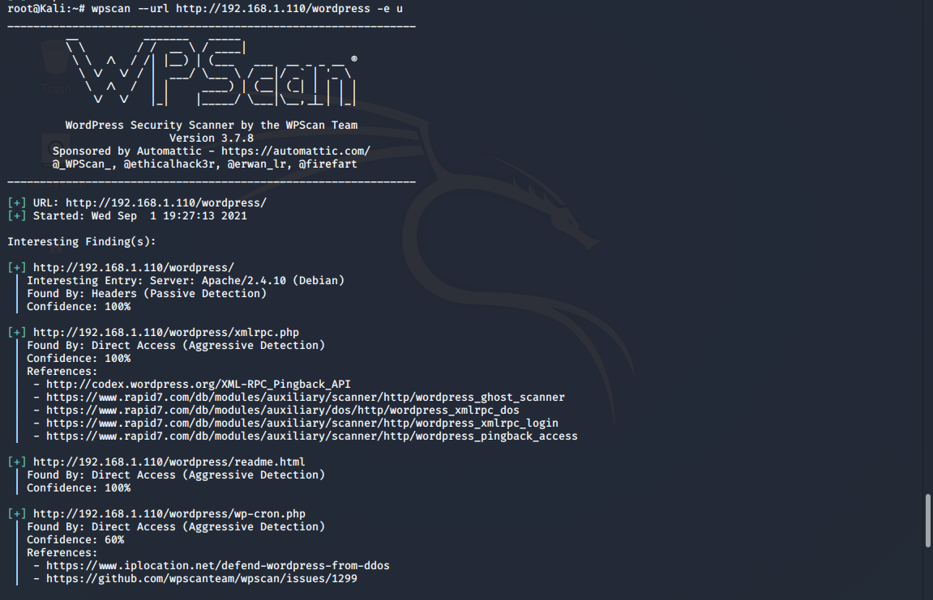
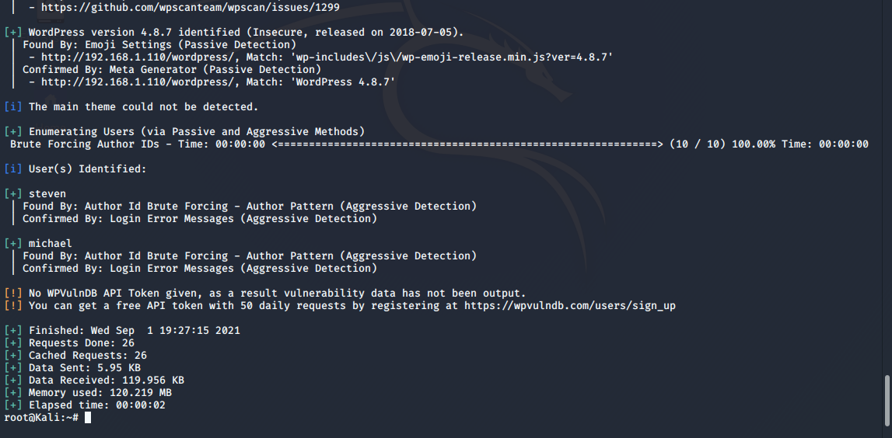
Exploitation: Target 1 : WORDPRESS USER ENUMERATION
A wpscan was carried out against the wordpress site that revealed two users

Slide 10
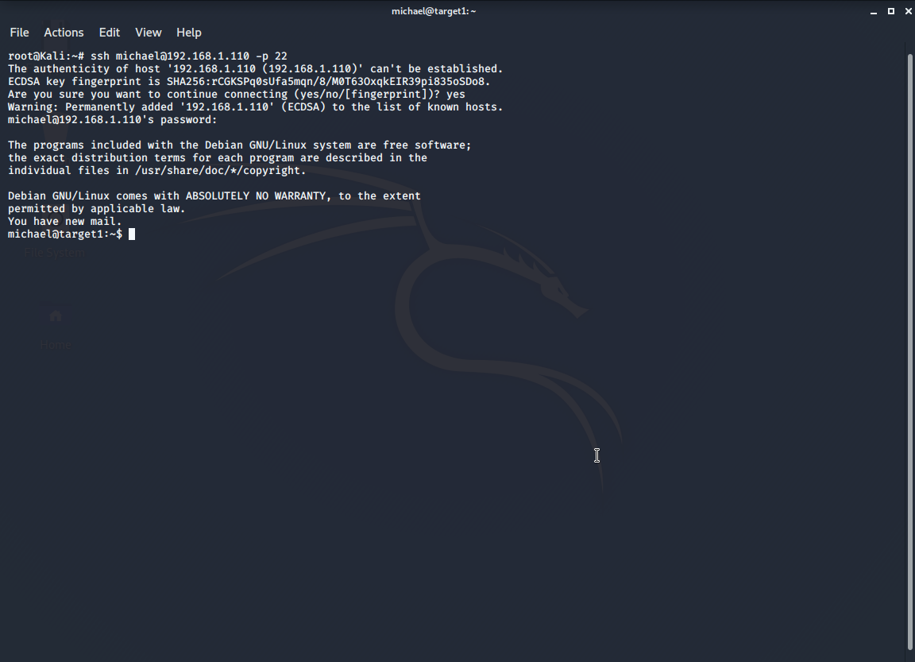
Exploitation: Target 1 : WEAK PASSWORD
Using the information received from the wordpress enumeration vulnerability. I was able to guess one of the users password which was the same as the username and SSH into the server.

Slide 11
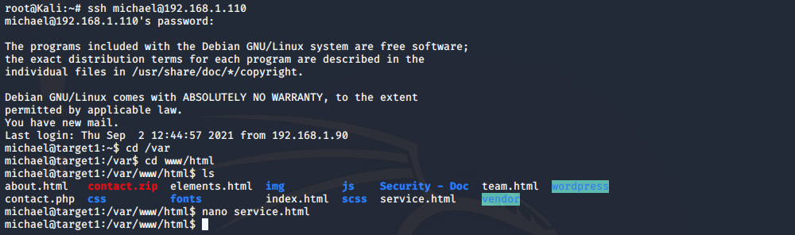
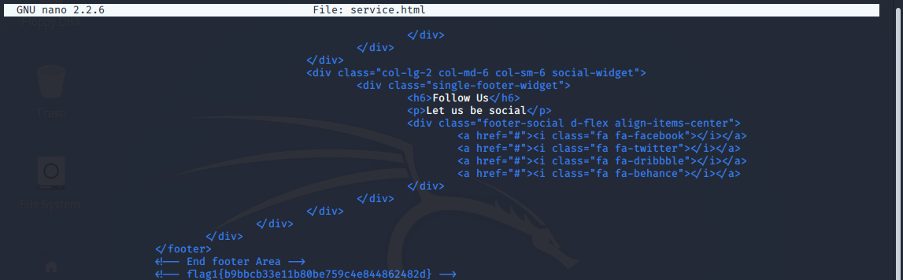
Exploitation: Target 1 : Wordpress configuration file for SQL databases stored in plain text.
After gaining access to the system, i was able to find flag 1 located in the service.html file within the /var/html/www directory

Slide 12
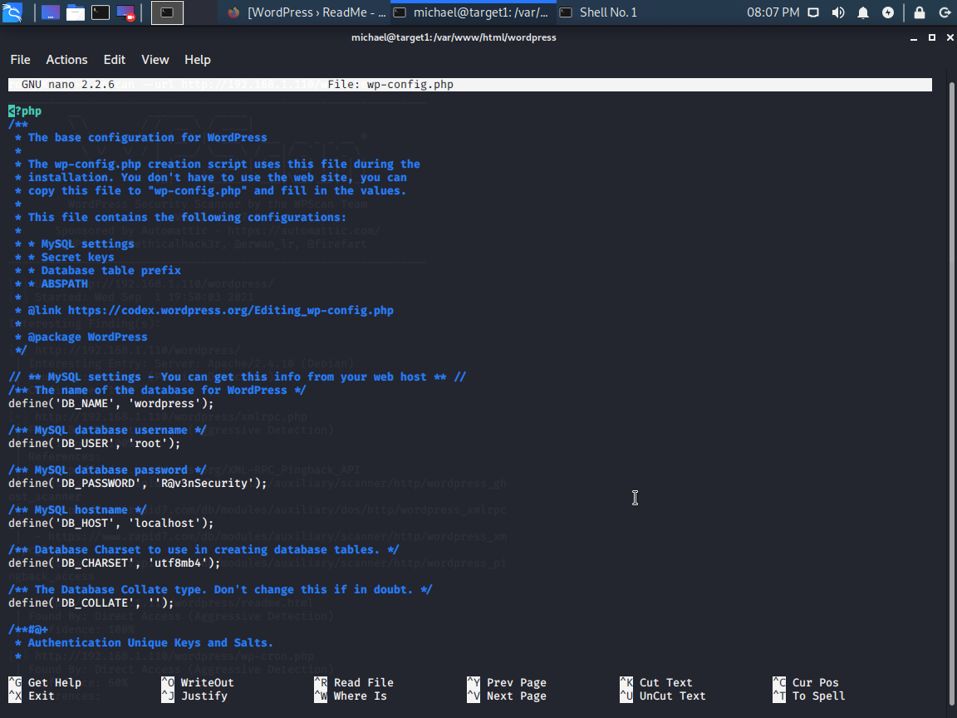
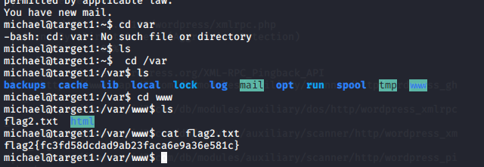
Exploitation: Wordpress configuration file for SQL databases stored in plain text.
continued
After that i was able to find the username and password for the SQL database within the wp-config.php file within the /var/www/html/wordpress directory and flag2 in the /var/www directory.

Slide 13
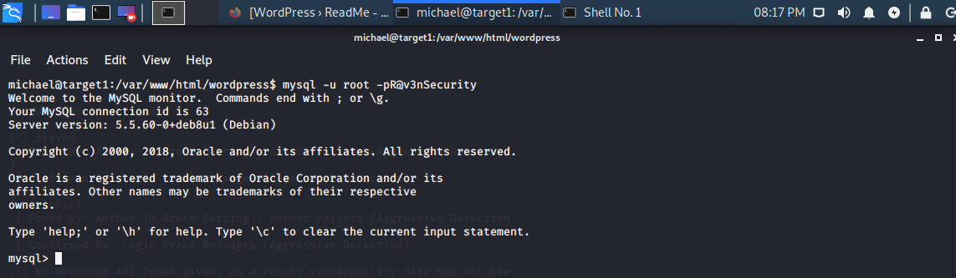
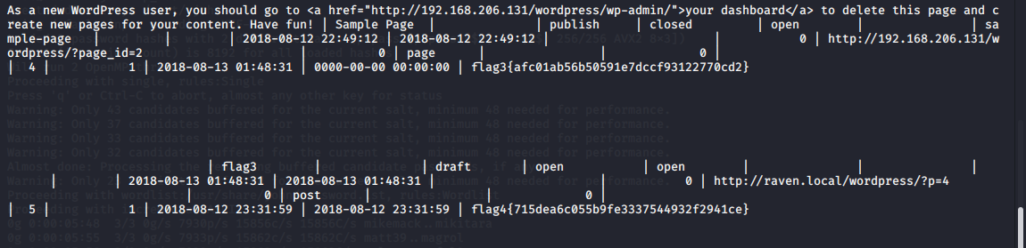
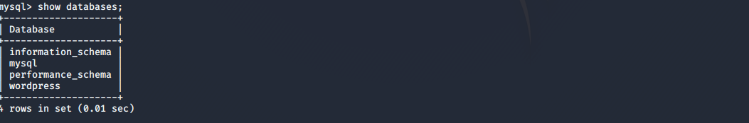
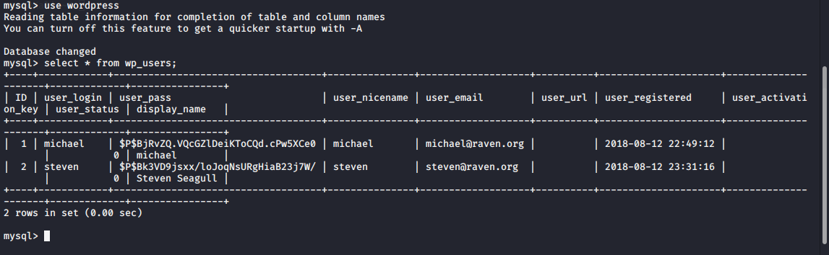
Exploitation: Wordpress configuration file for SQL databases stored in plain text.
continued
I logged into the sql databases with the username and password discovered and then i was able to get dump password hashes for wordpress users located within the database and also flag3

Slide 14
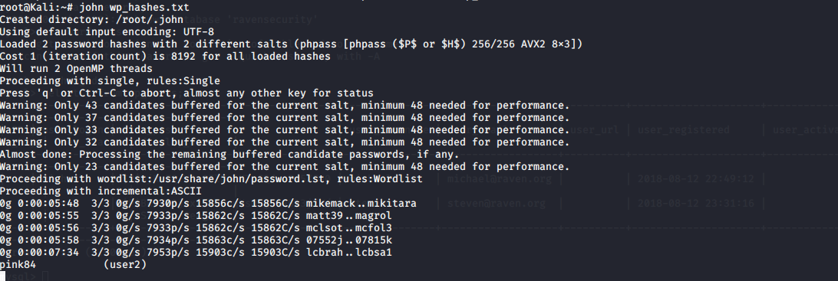
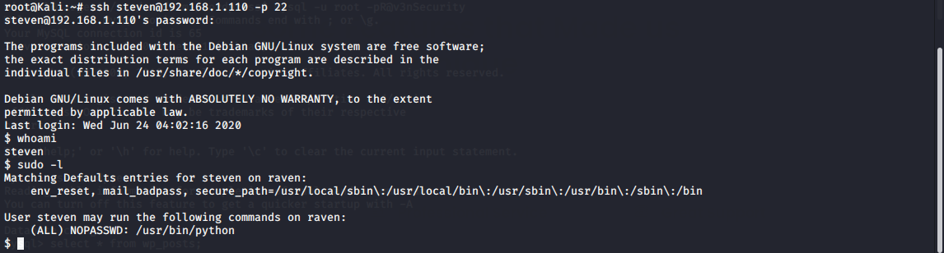
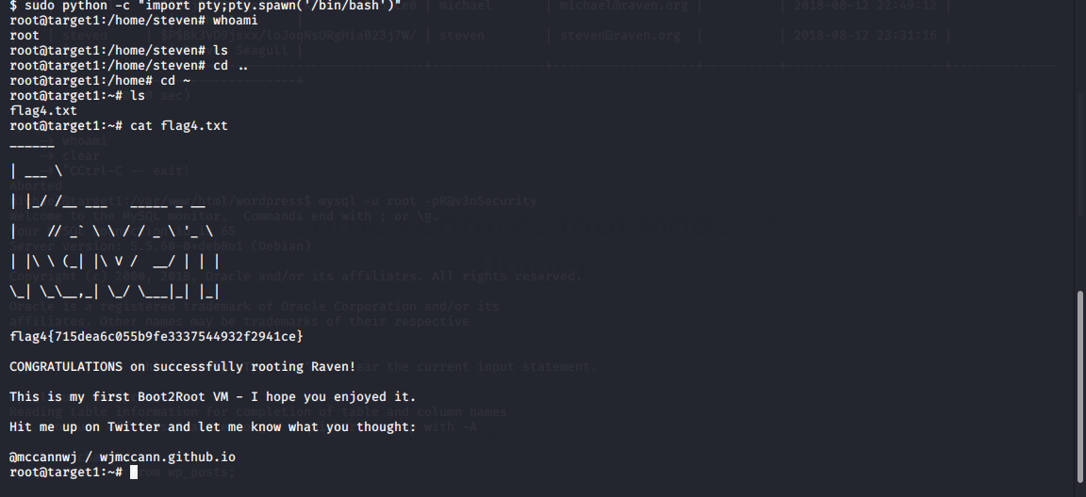
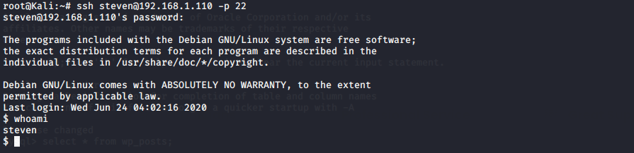
Exploitation: Target 1 : ALLOWS ESCALATING PRIVILEGES TO ROOT WITH A PYTHON SCRIPT.
Exploitation
After getting hashes from users via the sql databases. i was able to crack the password for Steven using john the ripper. With the password i was able to log into the system as Steven and escalate my privileges to a root user with a simple python command and also discover flag4.

Slide 15
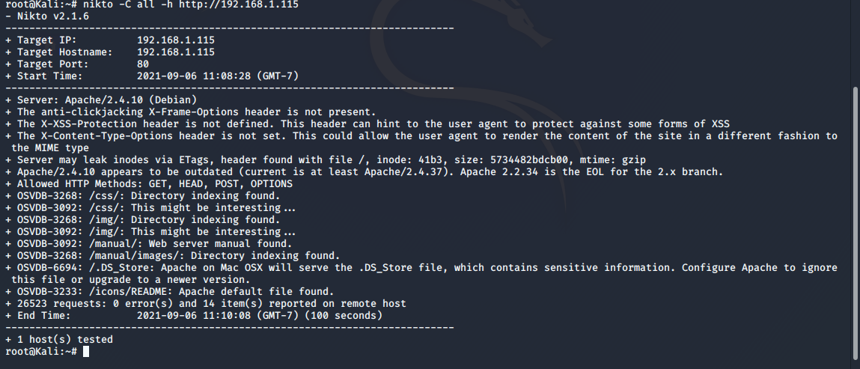
Exploitation : Target 2 : APACHE VERSION OUTDATED
explanation
Using a nikto scan, i discovered the apache version running on this server is outdated. This mean an attacker could look for critical vulnerabilities related to this outdated version and exploit it to gain access.

Slide 16
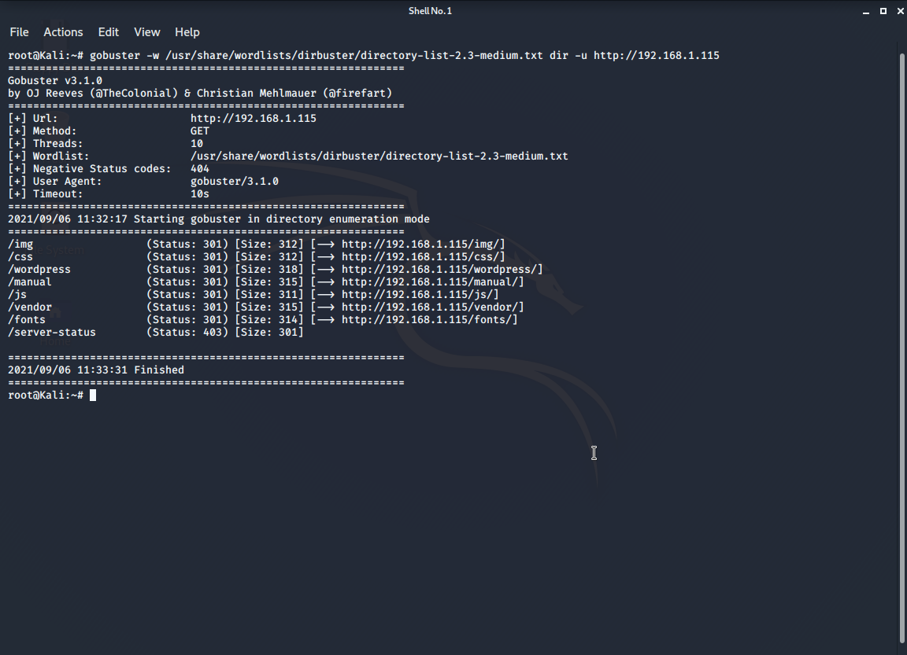
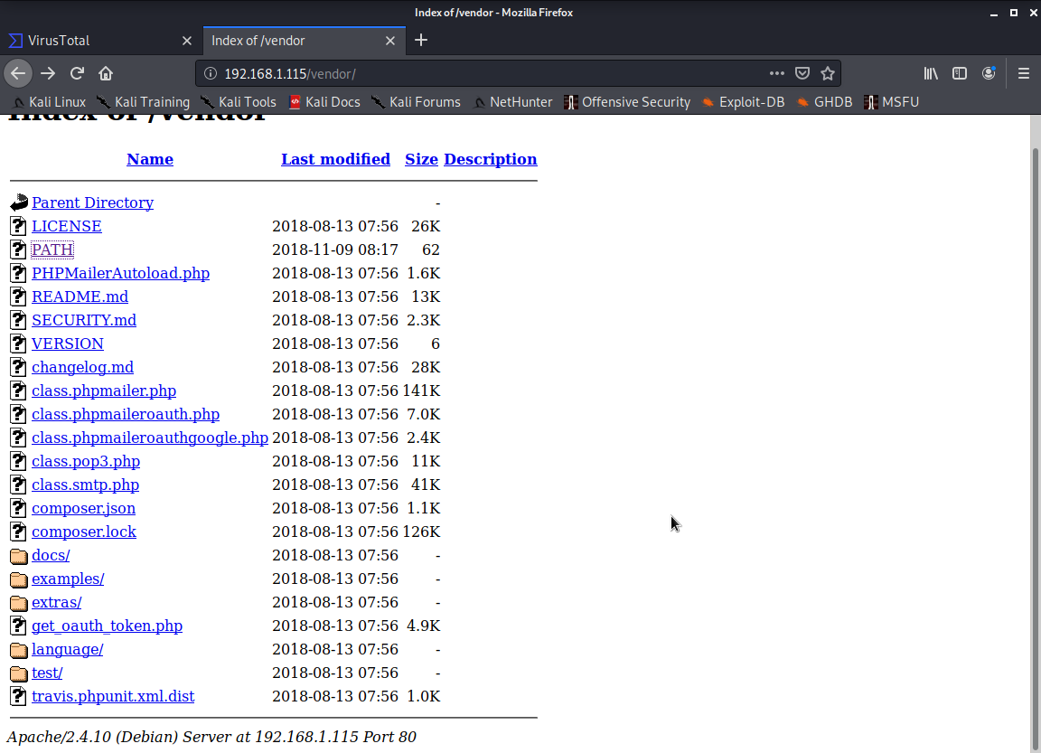
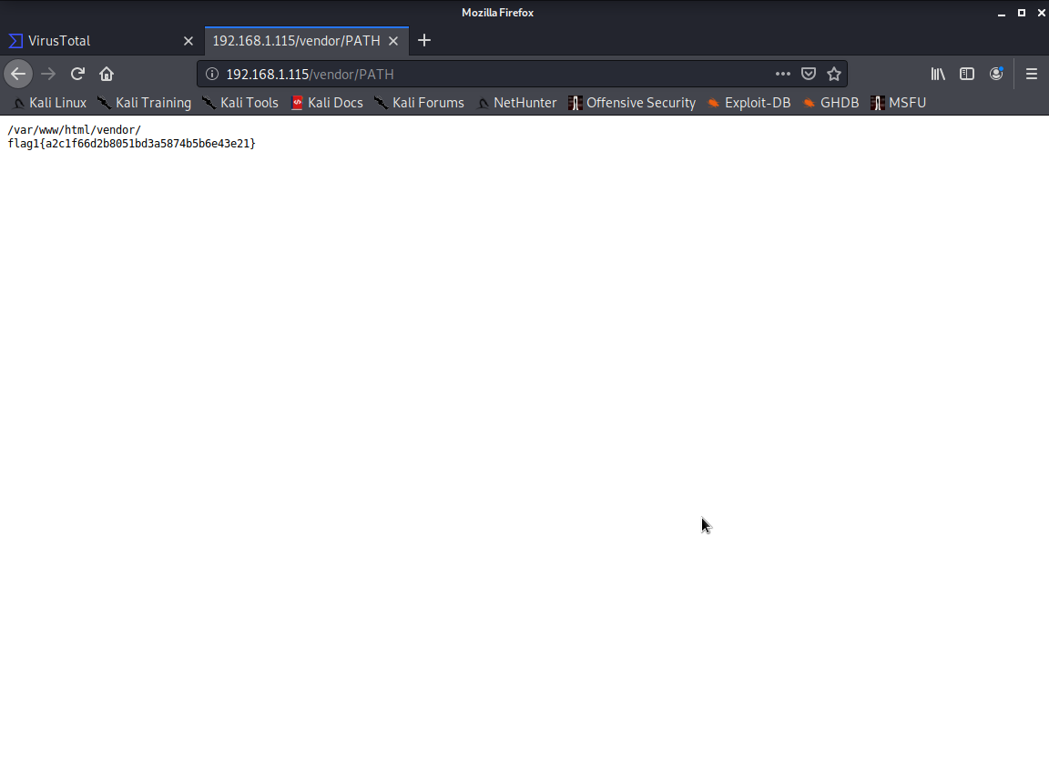
Exploitation : Target 2 : VULNERABLE TO URL BRUTE FORCING.
explained
This vulnerability allows an attacker to brute force and discover directories on a server with a simple enumeration tool (gobuster). I found flag1 after this in the vendor/PATH directory.

Slide 17
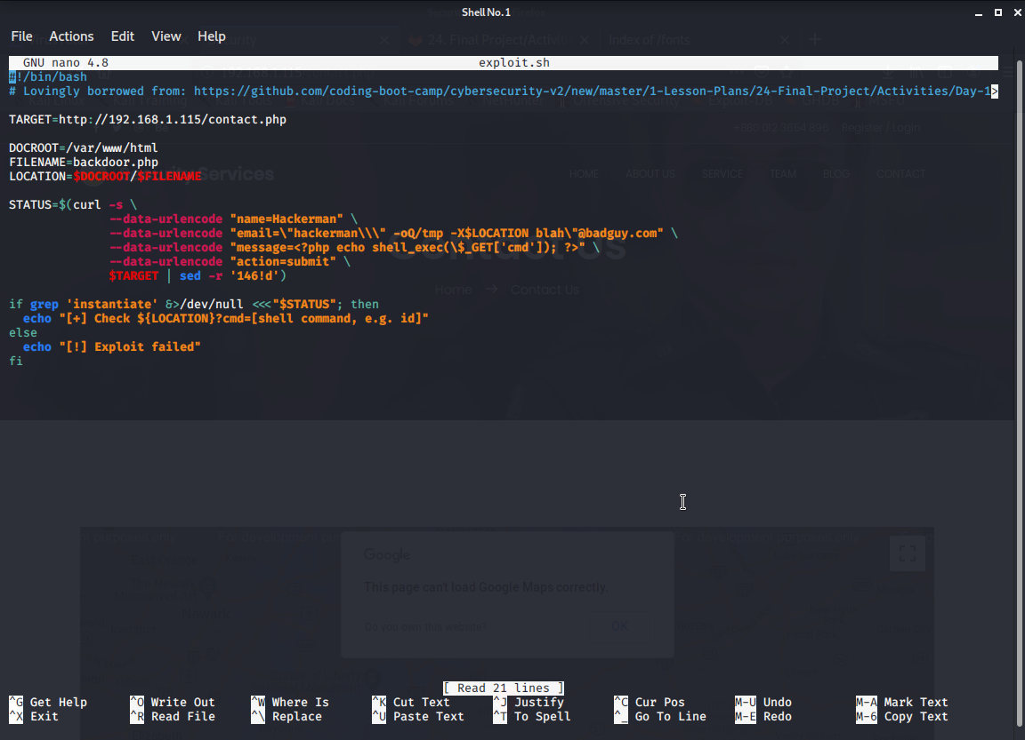
Exploitation : Target 2 : NETCAT REVERSE SHELL AND REMOTE CODE EXECUTION.
explained
A bash script called backdoor.php was uploaded to the server and using a netcat listener and the browser, a reverse shell was achieved. I was also able to execute commands via the URL and located flag2 in the /var/www directory and flag3 in the http://192.168.1.115/wordpress/wp-content/uploads/2018/11/flag3.png directory. all screenshots attached below :
bash script file edited targeting the contact.php page. bash script uploaded to server via http://192.168.1.115/contact.php page

Slide 18
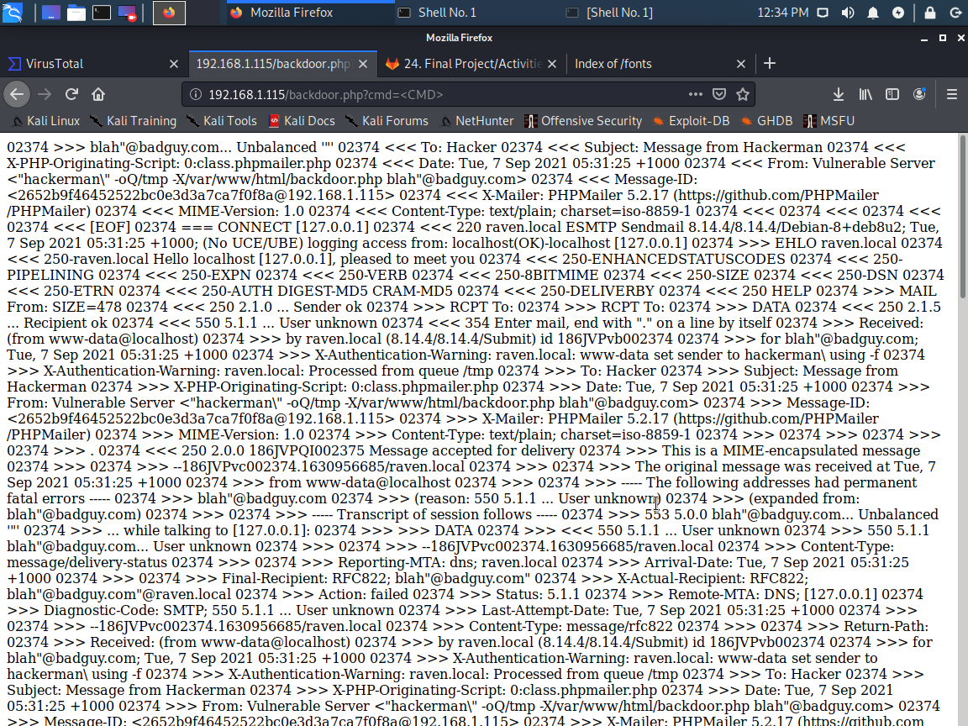
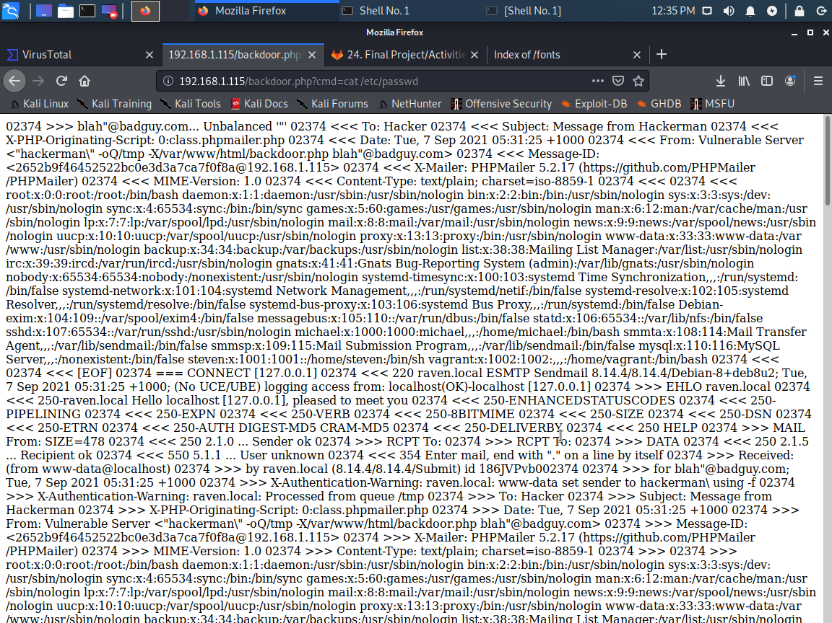
Exploitation : Target 2 : NETCAT REVERSE SHELL AND REMOTE CODE EXECUTION.
screenshots continued
confirmation of script uploaded i was able to cat /etc/shadow file

Slide 19
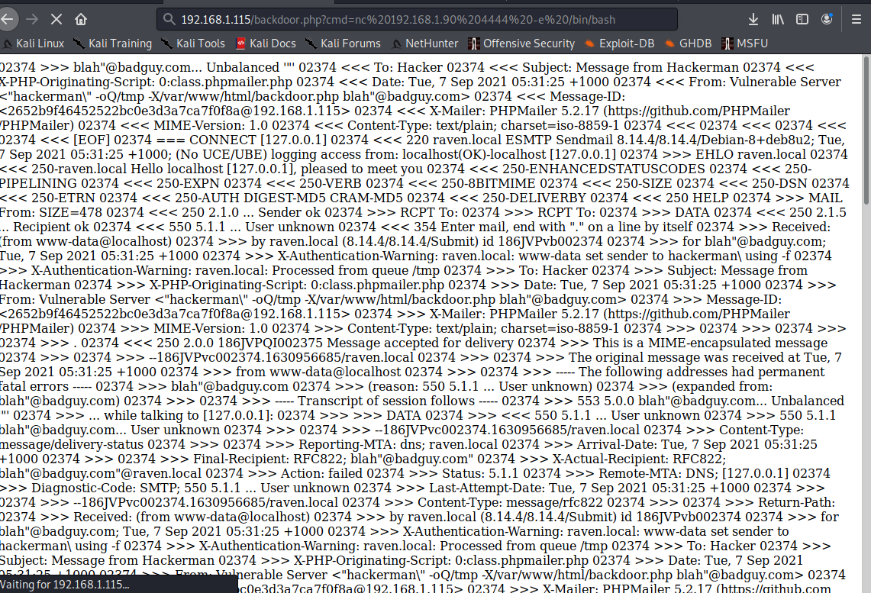
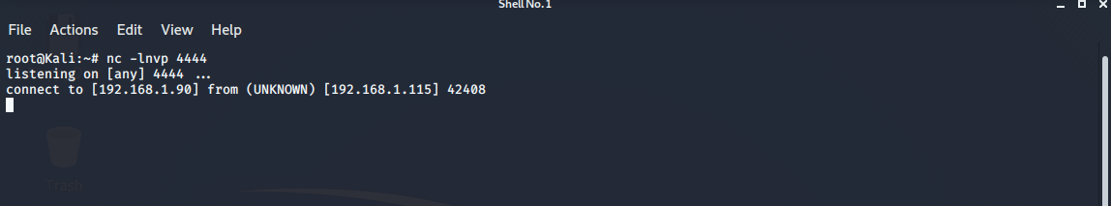
Exploitation : Target 2 : NETCAT REVERSE SHELL AND REMOTE CODE EXECUTION.
screenshots continued.
executing command to to start a reverse shell via netcat netcat connection achieved and reverse shell started

Slide 20
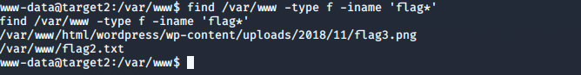
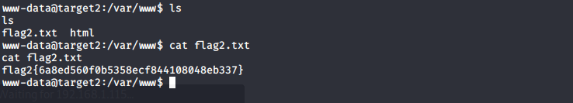
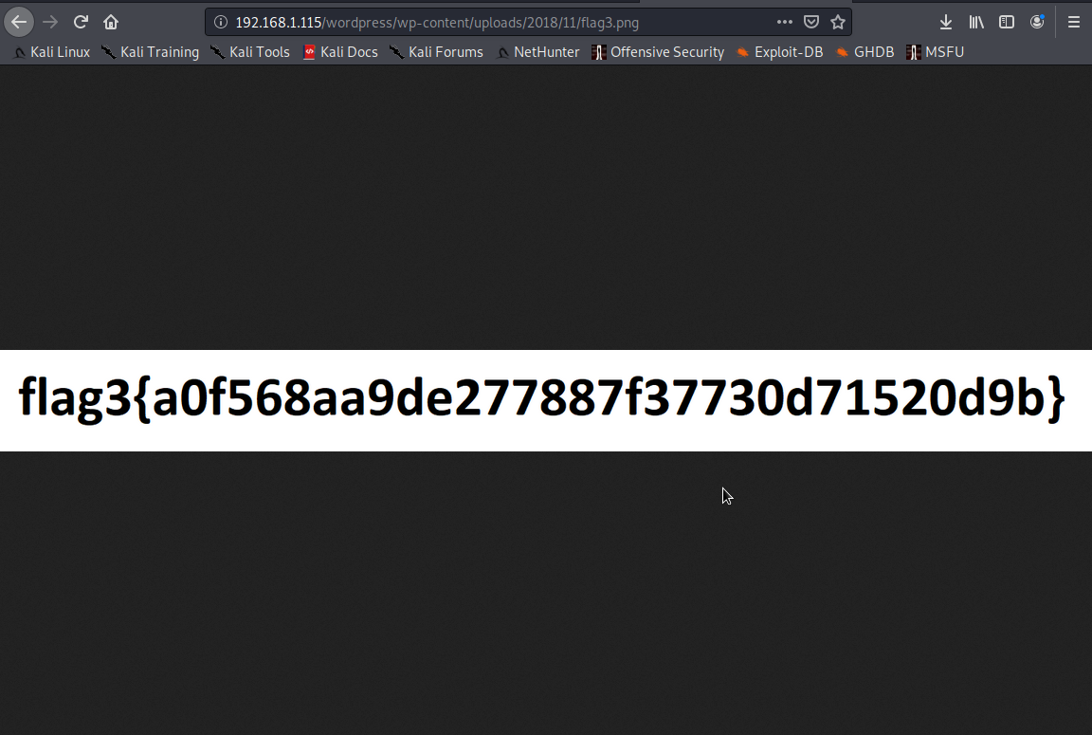
Exploitation : Target 2 : NETCAT REVERSE SHELL AND REMOTE CODE EXECUTION.
screenshots continued
command to find all flags flag2 in the /var/www directory
Flag3 in the http://192.168.1.115/wordpress/wp-content/uploads/2018/11/flag3.png url path.

Slide 21
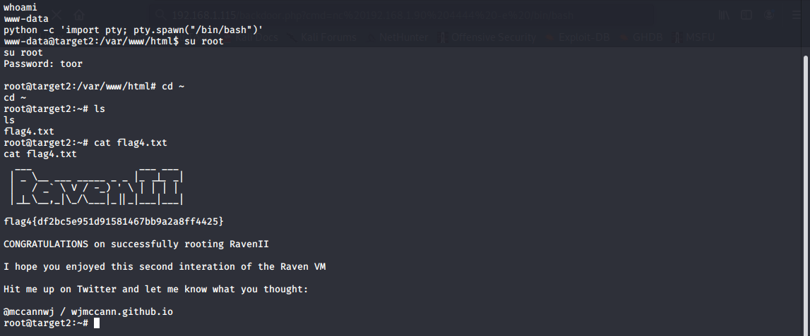
Exploitation : Target 2 : NETCAT REVERSE SHELL AND REMOTE CODE EXECUTION.
screenshot continued
With the Reverse shell, i was able to escalate to root by a simple password guess. The root user still had the Linux default password which is “toor”. This is a huge vulnerability as the password for the root account was weak and will be easily uncovered by guessing or a dictionary attack. i uncovered flag4 at this stage.

Slide 22
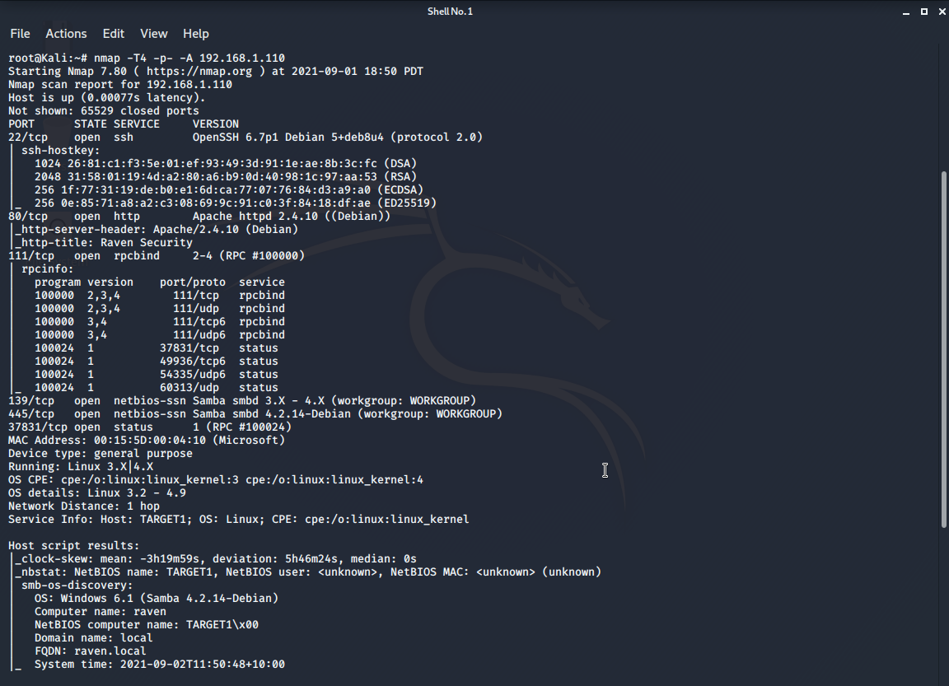
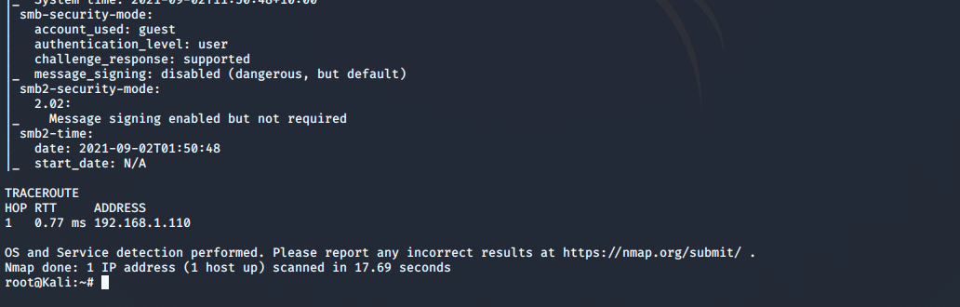
EXTRA SLIDES
SOME OTHER SCANS AND RECON
NMAP SCAN FOR TARGET 1

Slide 23
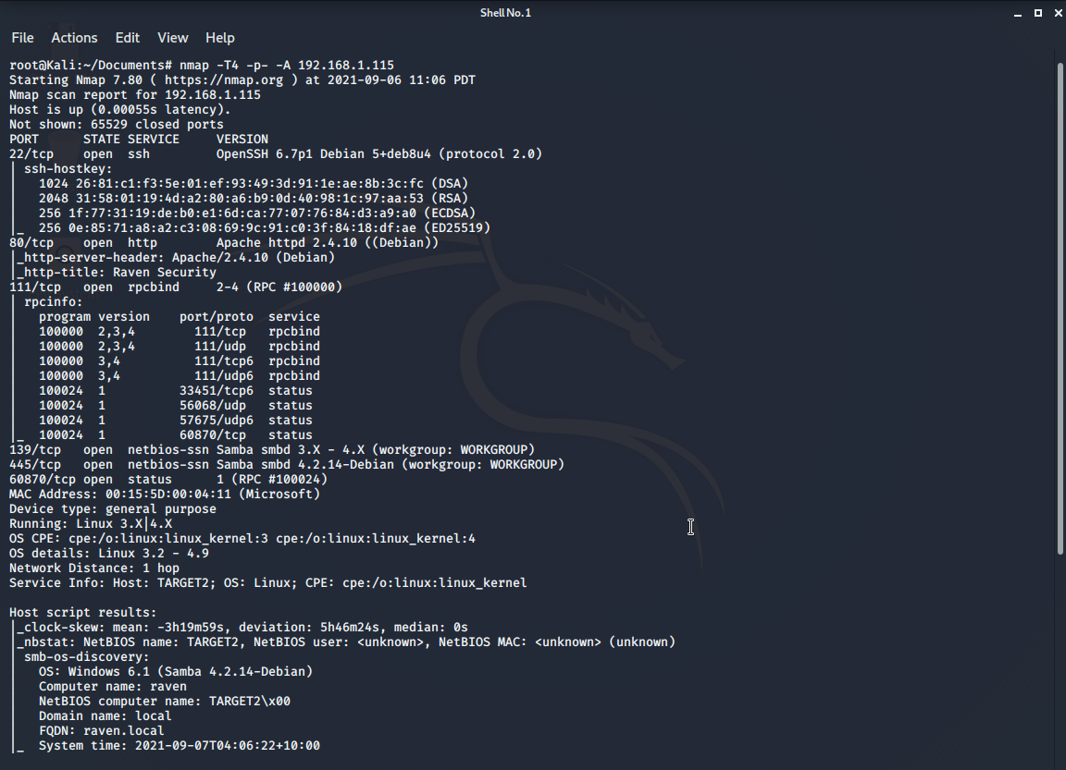
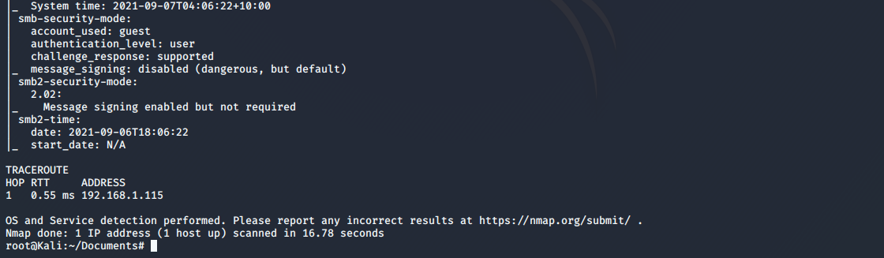
EXTRA SLIDES
SCANS AND RECON
NMAP SCAN FOR TARGET 2

Slide 24
Avoiding Detection
‹#›

Slide 25
Stealth Exploitation of WORDPRESS USER ENUMERATION.
Monitoring Overview
Which alerts detect this exploit?
Excessive HTTP Errors
Which metrics do they measure? WHEN count() GROUPED OVER top 5 'http.response.status_code' IS ABOVE 400 FOR THE LAST 5 minutes
Which thresholds do they fire at? 400
Mitigating Detection
How can you execute the same exploit without triggering the alert?
I can perform the scan in stealth mode using this syntax :
“wpscan --url [url] --stealthy”
Are there alternative exploits that may perform better?
wpscan is very effective in enumeration wordpress

Slide 26
Stealth Exploitation of ALLOWS ESCALATING PRIVILEGES TO ROOT WITH A PYTHON SCRIPT.
Monitoring Overview
Which alerts detect this exploit?
Alert me when a user elevates their privilege during a session
Which metrics do they measure?
continuous monitoring (PER EACH EVENT)
Which thresholds do they fire at? 1
Mitigating Detection
How can you execute the same exploit without triggering the alert?
Disabling event logging and monitoring as soon as you gain access
Are there alternative exploits that may perform better?
Meterpreter session

Slide 27
Stealth Exploitation of VULNERABLE TO URL BRUTE FORCING
Monitoring Overview
Which alerts detect this exploit? HTTP Request Size Monitor
Which metrics do they measure?
WHEN sum() of http.request.bytes OVER all documents IS ABOVE 3500 FOR THE LAST 1 minute
Which thresholds do they fire at? 3500
Mitigating Detection
How can you execute the same exploit without triggering the alert?
We can use a different url brute force tool that we can configure not to trigger any alerts
Are there alternative exploits that may perform better?
Using Dirbuster. Exceeding the warranted requests per second during an attack is a sure shot way to get flagged by any kind of detective measures put into place. DirBuster lets us control the requests per second to bypass this defense.

